Slide 1

Software Engineering (IT2020)
Lecture 8 - Supportive Processes

Slide 2
what is configuration management?
• Change management: managed way to decide which change ideas to implement and when.
• Version management: keep track of multiple versions of components and ensure that changes by different developers do not disturb each other.
• System building: collect and assemble correct versions of required components and then compile.
• Release management: prepare for external releases and keep track of external releases.

Slide 3
Configuration management activities

Slide 4
Agile development and CM
Agile development, where components and systems are changed several times per day, is impossible without using CM tools.
The definitive versions of components are held in a shared project repository and developers copy these into their own workspace.

Slide 5
Development phases
A development phase where the development team is responsible for managing the software configuration and new functionality is being added to the software.
A system testing phase where a version of the system is released internally for testing.
No new system functionality is added. Changes made are bug fixes, performance improvements and security vulnerability repairs.
A release phase where the software is released to customers for use.
New versions of the released system are developed to repair bugs and vulnerabilities and to include new features.

Slide 6
Multi-version systems
For large systems, there is never just one ‘working’ version of a system.
There are always several versions of the system at different stages of development.
There may be several teams involved in the development of different system versions.

Slide 7
Multi-version system development

Slide 8
Version management

Slide 9
Version Control
Allows different projects to use the same source files at the same time
Isolates work that is not ready to be shared by the rest of the project
Isolates work that should never be shared
Allows software engineers to continue development along a branch even when a line of development is frozen
Therefore version management can be thought of as the process of managing codelines and baselines.

Slide 10
Baselines
A work product becomes a baseline only after it is reviewed and approved.
A baseline is a milestone in software development that is marked by the delivery of one or more configuration items.
Once a baseline is established each change request must be evaluated and verified by a formal procedure before it is processed.

Slide 11
Codelines and baselines
A codeline is a sequence of versions of source code with later versions in the sequence derived from earlier versions.
Codelines normally apply to components of systems so that there are different versions of each component.
A baseline is a definition of a specific system.
The baseline therefore specifies the component versions that are included in the system plus a specification of the libraries used, configuration files, etc.

Slide 12
Codelines and baselines

Slide 13
Key features of version control systems
Version and release identification
Change history recording
Support for independent development
Project support
Storage management

Slide 14
Centralized version control
Developers check out components or directories of components from the project repository into their private workspace and work on these copies in their private workspace.
When their changes are complete, they check-in the components back to the repository.
If several people are working on a component at the same time, each check it out from the repository. If a component has been checked out, the VC system warns other users wanting to check out that component that it has been checked out by someone else.

Slide 15
Distributed version control
A ‘master’ repository is created on a server that maintains the code produced by the development team.
Instead of checking out the files that they need, a developer creates a clone of the project repository that is downloaded and installed on their computer.
Developers work on the files required and maintain the new versions on their private repository on their own computer.
When changes are done, they ‘commit’ these changes and update their private server repository. They may then ‘push’ these changes to the project repository.

Slide 16
Open source development
Distributed version control is essential for open source development.
Several people may be working simultaneously on the same system without any central coordination.
As well as a private repository on their own computer, developers also maintain a public server repository to which they push new versions of components that they have changed.
It is then up to the open-source system ‘manager’ to decide when to pull these changes into the definitive system.

Slide 17
System building

Slide 18
System building
The process of compiling and linking software components into an executable system.
System building is the process of creating a complete, executable system by compiling and linking the system components, external libraries, configuration files, etc.

Slide 19
Change management

Slide 20
Change management
Organizational needs and requirements change during the lifetime of a system, bugs have to be repaired and systems have to adapt to changes in their environment.
Change management is intended to ensure that system evolution is a managed process and that priority is given to the most urgent and cost-effective changes.
The change management process is concerned with analyzing the costs and benefits of proposed changes, approving those changes that are worthwhile and tracking which components in the system have been changed.

Slide 21
The change management process

Slide 22
A partially completed change request form (a)
Change Request Form
Project: SICSA/AppProcessing Number: 23/02
Change requester: I. Sommerville Date: 20/07/12
Requested change: The status of applicants (rejected, accepted, etc.) should be shown visually in the displayed list of applicants.
Change analyzer: R. Looek Analysis date: 25/07/12
Components affected: ApplicantListDisplay, StatusUpdater
Associated components: StudentDatabase

Slide 23
A partially completed change request form (b)
Change Request Form
Change assessment: Relatively simple to implement by changing the display color according to status. A table must be added to relate status to colors. No changes to associated components are required.
Change priority: Medium
Change implementation:
Estimated effort: 2 hours
Date to SGA app. team: 28/07/12 CCB decision date: 30/07/12
Decision: Accept change. Change to be implemented in Release 1.2
Change implementor: Date of change:
Date submitted to QA: QA decision:
Date submitted to CM:
Comments:

Slide 24
Factors in change analysis
The consequences of not making the change
The benefits of the change
The number of users affected by the change
The costs of making the change
The product release cycle

Slide 25
Derivation history
// SICSA project (XEP 6087)
//
// APP-SYSTEM/AUTH/RBAC/USER_ROLE
//
// Object: currentRole
// Author: R. Looek
// Creation date: 13/11/2012
//
// © St Andrews University 2012
//
// Modification history
// Version Modifier Date Change Reason
// 1.0 J. Jones 11/11/2009 Add header Submitted to CM
// 1.1 R. Looek 13/11/2012 New field Change req. R07/02

Slide 26
Change management and agile methods
In some agile methods, customers are directly involved in change management.
The propose a change to the requirements and work with the team to assess its impact and decide whether the change should take priority over the features planned for the next increment of the system.
Changes to improve the software improvement are decided by the programmers working on the system.
Refactoring, where the software is continually improved, is not seen as an overhead but as a necessary part of the development process.

Slide 27
Release management

Slide 28
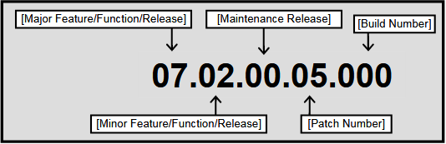
Release management
A system release is a version of a software system that is distributed to customers.
Types of releases
Major releases - deliver significant new functionality
Minor releases - repair bugs and fix customer problems
Release Numbering
Several Notations
major.minor[.build[.revision]]
major.minor[.maintenance[.build]]

Slide 29
Release components
Executable Code
configuration files
Data files, such as files of error messages, that are needed for successful system operation;
Installation program
Electronic and paper documentation describing the system;
Packaging and associated publicity that have been designed for that release.

Slide 30
Factors influencing system release planning
Factor | Description
Competition | For mass-market software, a new system release may be necessary because a competing product has introduced new features and market share may be lost if these are not provided to existing customers.
Marketing requirements | The marketing department of an organization may have made a commitment for releases to be available at a particular date.
Platform changes | You may have to create a new release of a software application when a new version of the operating system platform is released.
Technical quality of the system | If serious system faults are reported which affect the way in which many customers use the system, it may be necessary to issue a fault repair release. Minor system faults may be repaired by issuing patches (usually distributed over the Internet) that can be applied to the current release of the system.

Slide 31
Release creation
Identify items
The executable code of the programs and all associated data files must be identified in the version control system.
Set Configurations
Configuration descriptions may have to be written for different hardware and operating systems.
Configuration Guidelines
Update instructions may have to be written for customers who need to configure their own systems.
Installation Scripts
Scripts for the installation program may have to be written.
Documentation on Web
Web pages have to be created describing the release, with links to system documentation.
Create the release
When all information is available, an executable master image of the software must be prepared and handed over for distribution to customers or sales outlets.

Slide 32
Release planning
As well as the technical work involved in creating a release distribution, advertising and publicity material have to be prepared and marketing strategies put in place to convince customers to buy the new release of the system.
Release timing
If releases are too frequent or require hardware upgrades, customers may not move to the new release, especially if they have to pay for it.
If system releases are too infrequent, market share may be lost as customers move to alternative systems.

Slide 33


Software as a service (Saas)
Traditional Software
On-Demand Utility
Plug In, Subscribe Pay-per-Use
Build Your Own

Slide 34
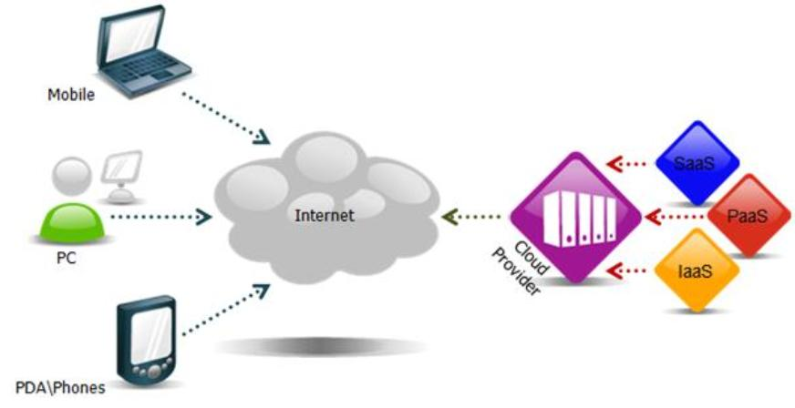
Cloud Computing

Slide 35
Traditional packaged software
Software as a service
Designed for customers to install, manage and maintain.
Designed from the outset up for delivery as Internet-based services
Architect solutions to be run by an individual company in a dedicated instantiation of the software
Designed to run thousands of different customers on a single code

Slide 36
Traditional packaged software
Software as a service
Infrequent, major upgrades every 18-24 months, sold individually to each installed base customer.
Frequent, "digestible" upgrades every 3-6 months to minimize customer disruption and enhance satisfaction.
Version control
Upgrade fee
Fixing a problem for one customer fixes it for everyone
Streamlined, repeatable functionality via Web services, open APIs and standard connectors
May use open APIs and Web services to facilitate integration, but each customer must typically pay for one-off integration work.

Slide 37
Software as a service
Delivering software as a service (SaaS) reduces the problems of release management.
It simplifies both release management and system installation for customers.
The software developer is responsible for replacing the existing release of a system with a new release and this is made available to all customers at the same time.

Slide 38
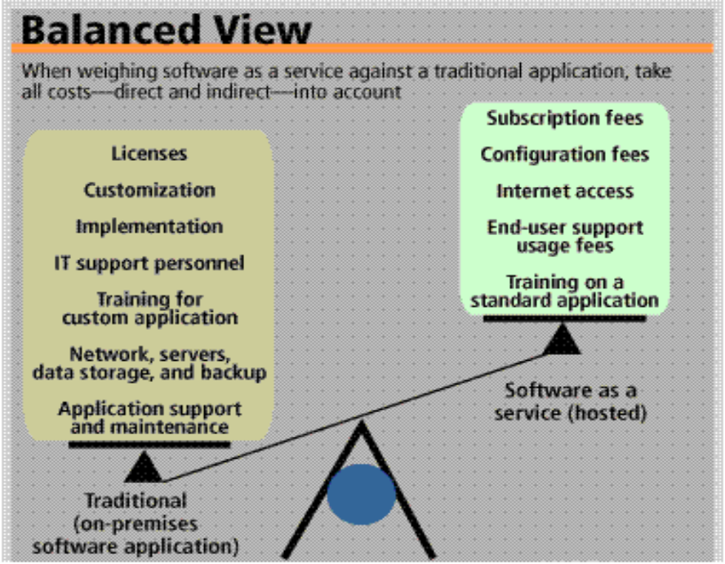
Software as a service

Slide 39
Factors influencing system release planning
Factor | Description
Competition | For mass-market software, a new system release may be necessary because a competing product has introduced new features and market share may be lost if these are not provided to existing customers.
Marketing requirements | The marketing department of an organization may have made a commitment for releases to be available at a particular date.
Platform changes | You may have to create a new release of a software application when a new version of the operating system platform is released.
Technical quality of the system | If serious system faults are reported which affect the way in which many customers use the system, it may be necessary to issue a fault repair release. Minor system faults may be repaired by issuing patches (usually distributed over the Internet) that can be applied to the current release of the system.

Slide 40
Software as a service
Delivering software as a service (SaaS) reduces the problems of release management.
It simplifies both release management and system installation for customers.
The software developer is responsible for replacing the existing release of a system with a new release and this is made available to all customers at the same time.

Slide 41
CM terminology
Term | Explanation
Baseline | A baseline is a collection of component versions that make up a system. Baselines are controlled, which means that the versions of the components making up the system cannot be changed. This means that it is always possible to recreate a baseline from its constituent components.
Branching | The creation of a new codeline from a version in an existing codeline. The new codeline and the existing codeline may then develop independently.
Codeline | A codeline is a set of versions of a software component and other configuration items on which that component depends.
Configuration (version) control | The process of ensuring that versions of systems and components are recorded and maintained so that changes are managed and all versions of components are identified and stored for the lifetime of the system.
Configuration item or software configuration item (SCI) | Anything associated with a software project (design, code, test data, document, etc.) that has been placed under configuration control. There are often different versions of a configuration item. Configuration items have a unique name.
Mainline | A sequence of baselines representing different versions of a system.

Slide 42
CM terminology
Term | Explanation
Merging | The creation of a new version of a software component by merging separate versions in different codelines. These codelines may have been created by a previous branch of one of the codelines involved.
Release | A version of a system that has been released to customers (or other users in an organization) for use.
Repository | A shared database of versions of software components and meta-information about changes to these components.
System building | The creation of an executable system version by compiling and linking the appropriate versions of the components and libraries making up the system.
Version | An instance of a configuration item that differs, in some way, from other instances of that item. Versions always have a unique identifier.
Workspace | A private work area where software can be modified without affecting other developers who may be using or modifying that software.

Slide 43
Incident management

Slide 44
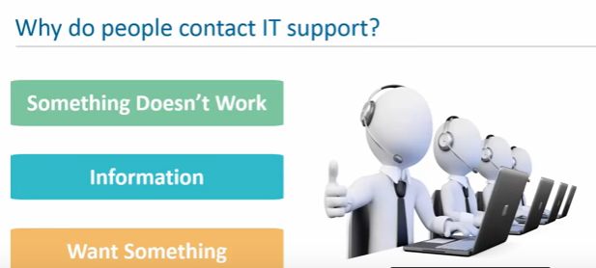
Incident Management
Notes:
44

Slide 45
Why not just help desk?
Traditional IT help desk environments can’t respond to rapidly expanding user expectation and are not designed for the complete scale of modern IT.
They rely on standalone tools and manual activities, making it incredibly difficult to engage effectively with users.
Incident management modernizes and transforms your IT help deck, dramatically increasing efficiency while improving service levels.
Engage online and real-time visibility of help desk performance.

Slide 46
Incident Management
Incident is an unplanned interruption to an IT service or reduction in the quality of an IT service.
Incident Management is the process for dealing with all incidents; this can include failures, questions or queries reported by the users (usually via a telephone call to the Service Desk ), by technical staff, or automatically detected and reported by event monitoring tools.

Slide 47
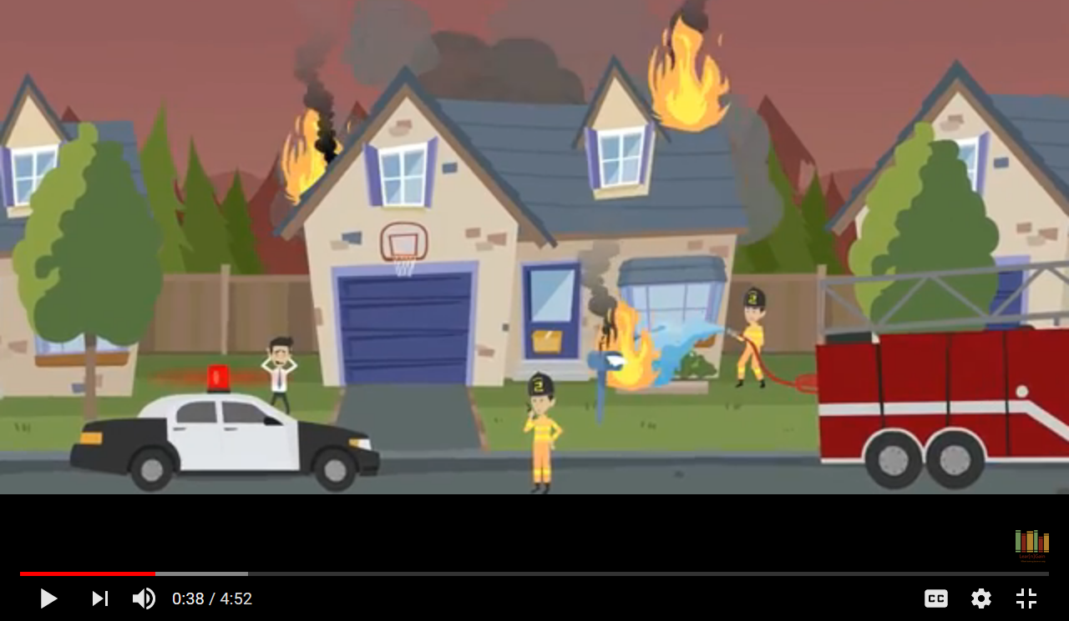
Examples of Incident

Slide 48
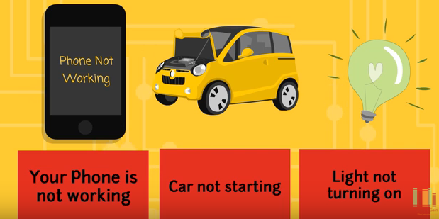
Cont..

Slide 49
Primary goal
The primary goal of the Incident Management process is to restore normal service operation as quickly as possible, after an incident has occurred to that service, and minimize the adverse impact on business operations.

Slide 50
Goals of incident Management
Restore the service as quickly as possible
Minimum distribution to users’ work
Management of an incident during its entire lifecycle
Support of operational activities

Slide 51
The Incident Process
Incident identification
Incident logging
Incident categorization
Incident prioritization
Incident response
Initial diagnosis
Incident escalation
Investigation and diagnosis
Resolution and recovery
Incident closure

Slide 52
Incident identification
The first step in the life of an incident is incident identification.
Incidents come from users in whatever forms the organization allows.
Sources of incident reporting include walk-ups, self-service, phone calls, emails, support chats, and automated notices, such as network monitoring software or system scanning utilities.

Slide 53
Cont..
The service desk then decides if the issue is truly an incident or if it’s a request.
Requests are categorized and handled differently than incidents, and they fall under request fulfillment.

Slide 54
Incident logging
Once identified as an incident, the service desk logs the incident as a ticket.
The ticket should include information, such as the user’s name and contact information, the incident description, and the date and time of the incident report

Slide 55
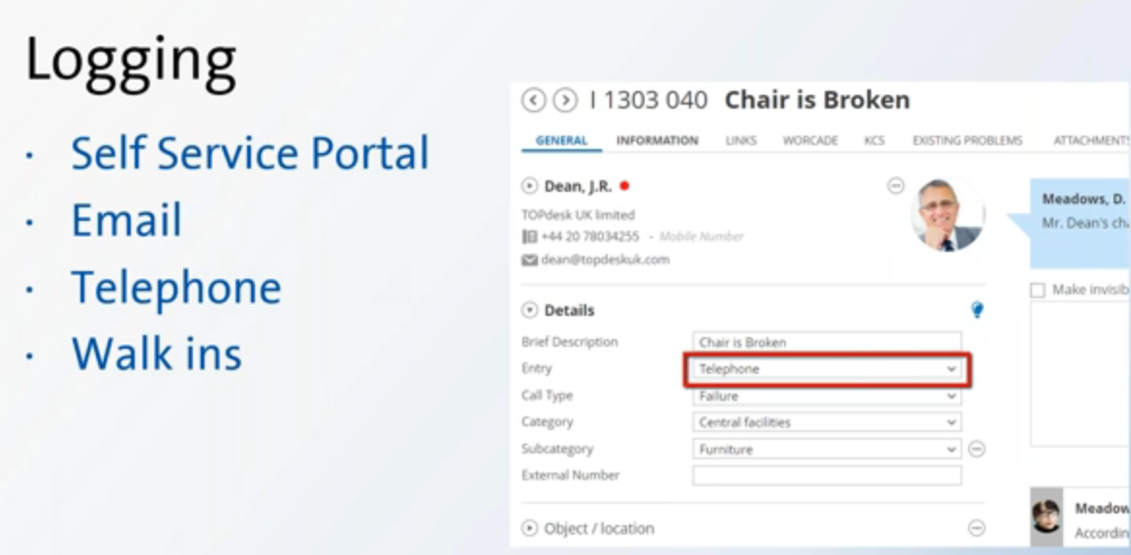

Slide 56
Incident categorization
Categorization involves assigning a category and at least one subcategory to the incident.
This action serves several purposes. First, it allows the service desk to sort and model incidents based on their categories and subcategories.
Second, it allows some issues to be automatically prioritized. For example, an incident might be categorized as “network” with a sub-category of “network outage”.

Slide 57
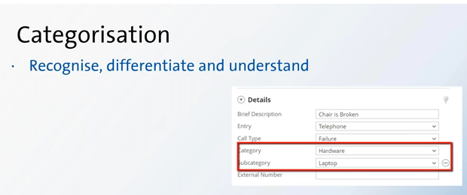

Slide 58
Incident prioritization
An incident’s priority is determined by its impact on users and on the business and its urgency.
Urgency is how quickly a resolution is required; impact is the measure of the extent of potential damage the incident may cause.
Low-priority incidents
Medium-priority incidents
High-priority incidents.

Slide 59
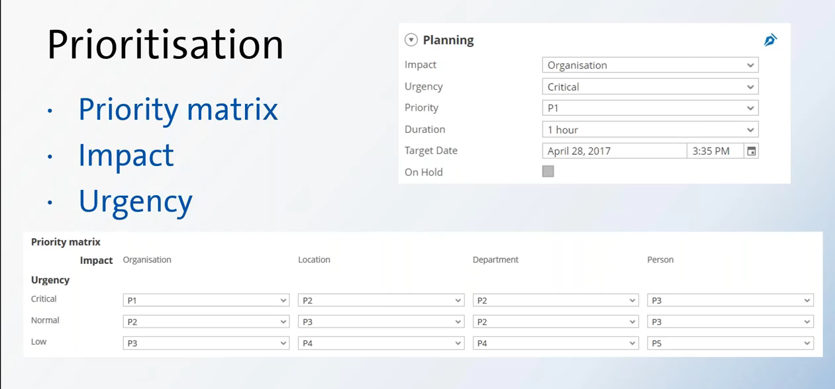

Slide 60
Incident response
Initial diagnosis: This occurs when the user describes his or her problem and answers troubleshooting questions.
Incident escalation: This happens when an incident requires advanced support, such as sending an on-site technician or assistance from certified support staff
Investigation and diagnosis: These processes take place during troubleshooting when the initial incident hypothesis is confirmed as being correct. Once the incident is diagnosed, staff can apply a solution, such as changing software settings, applying a software patch, or ordering new hardware.

Slide 61
Cont..
Resolution and recovery: This is when the service desk confirms that the user’s service has been restored to the required SLA level.
Incident closure: At this point, the incident is considered closed and the incident process ends.

Slide 62
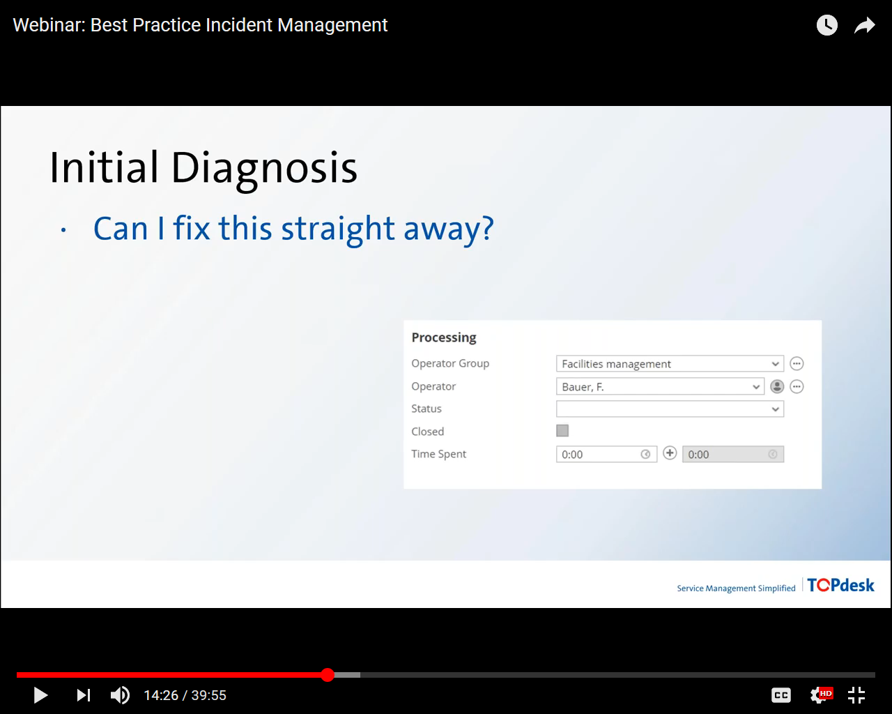
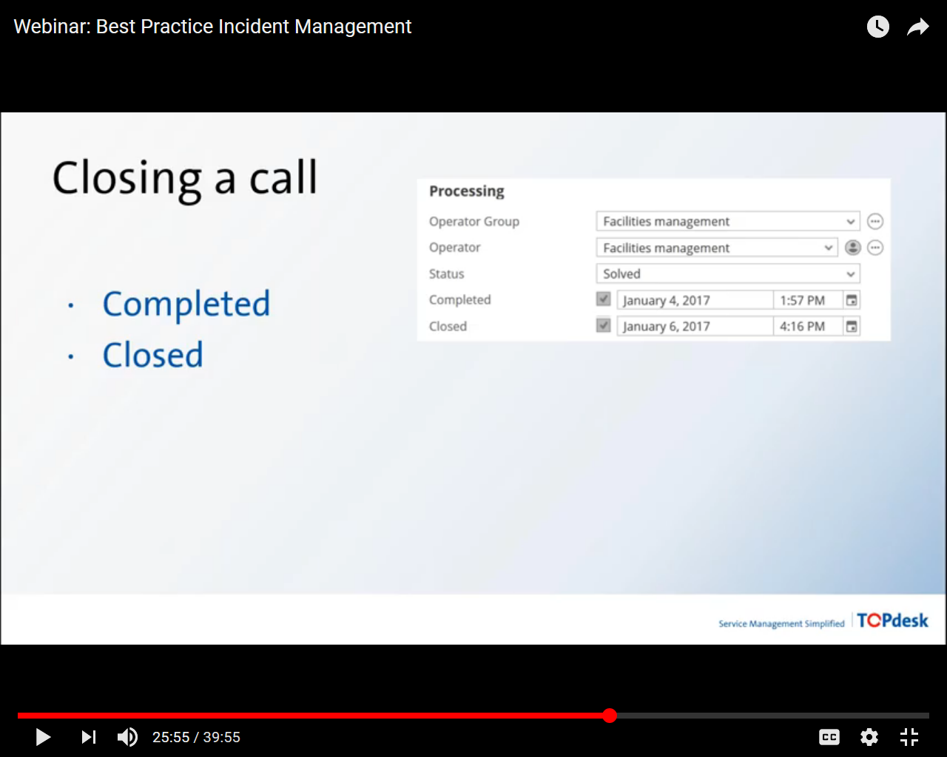
Incident response

Slide 63
Incident Template

Slide 64
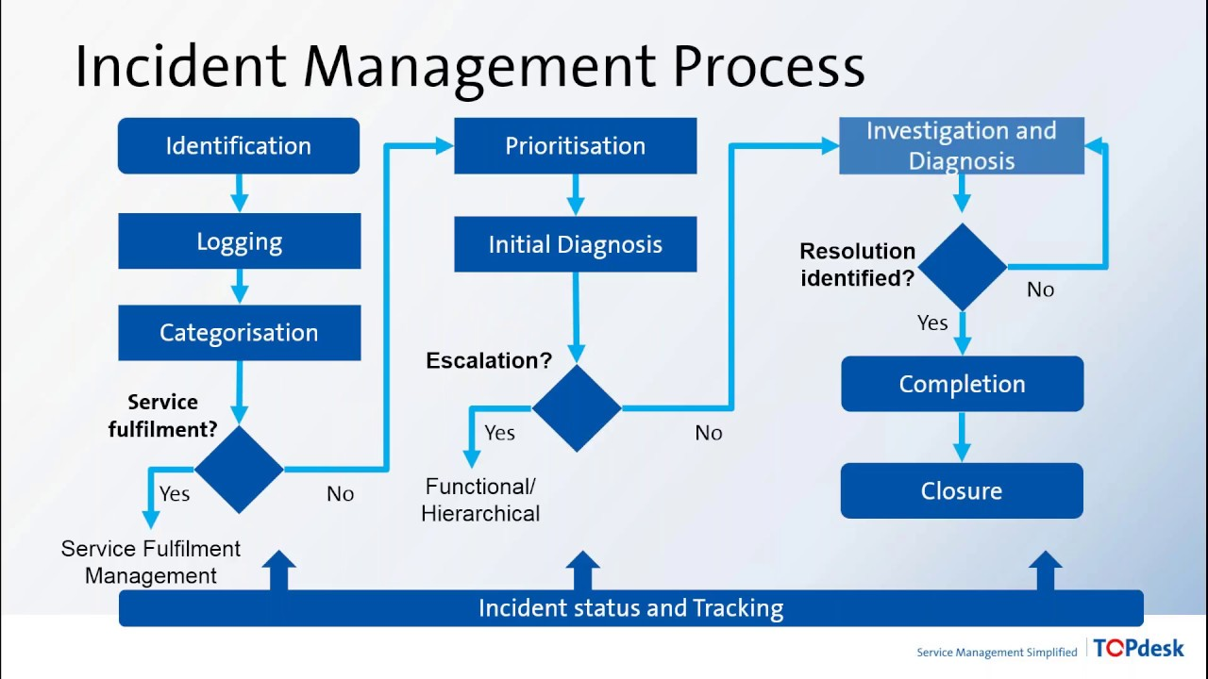

Slide 65
Incident statuses
Incident statuses mirror the incident process and include:
New
Assigned
In progress
On hold or pending
Resolved
Closed

Slide 66
Benefits
Reduced business impact of incident by timely resolution
Proactive identification of possible enhancements
Improved monitoring
Better staff utilization
Better customer satisfaction

Slide 67
References
http://www.bmcsoftware.com.au/guides/itil-incident-management.html
https://www.slideshare.net/agnihotry/itil-incident-managementfor-beginners

